Slide 1
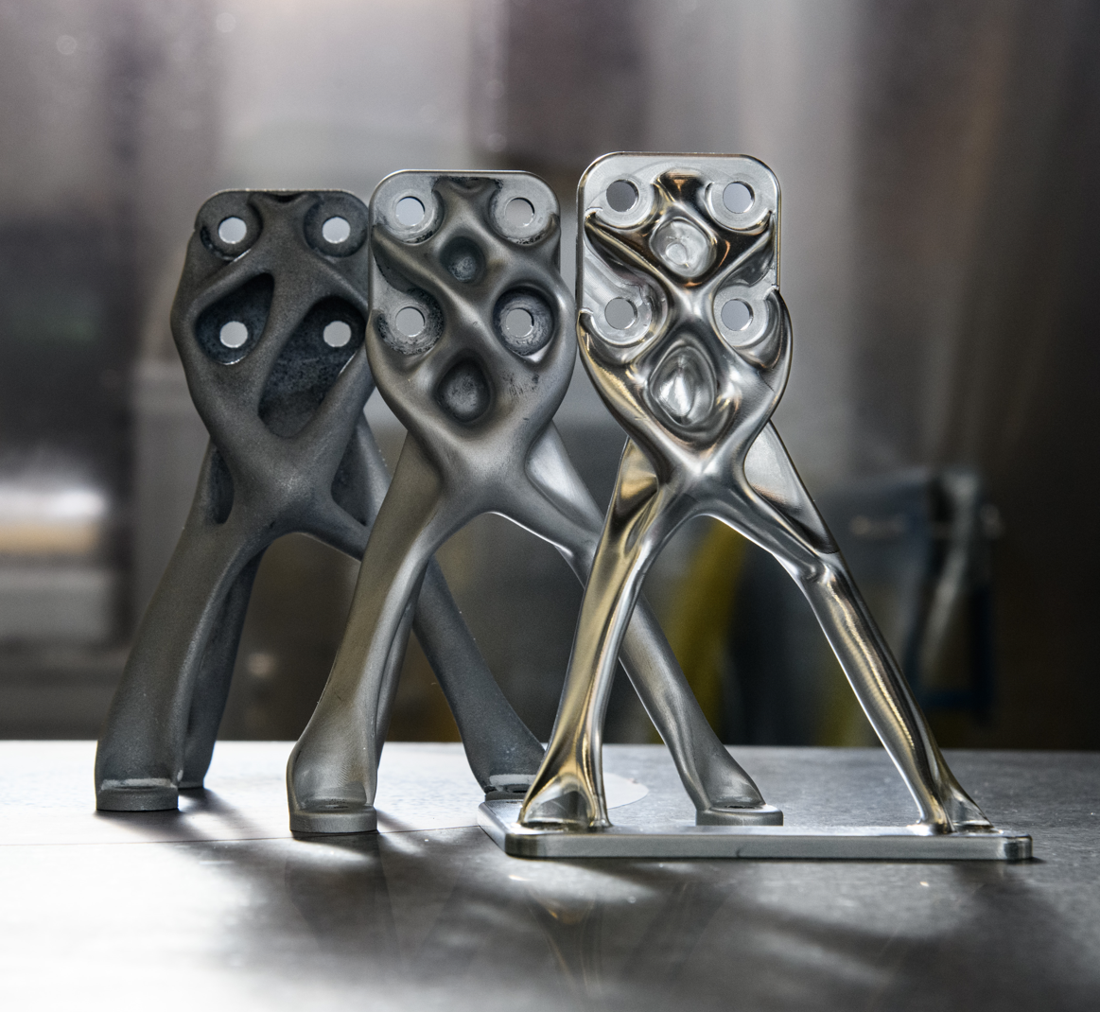
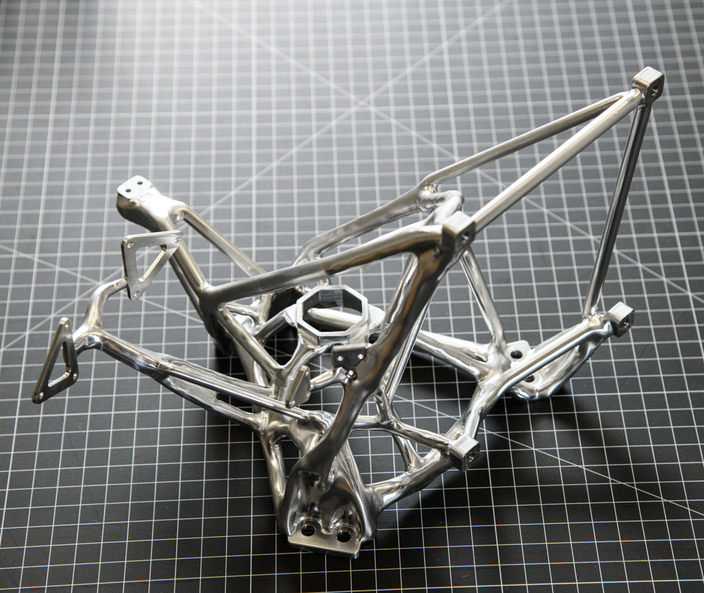
Evolved Structures: Generative Design and Digital Manufacturing at GSFC
Ryan McClelland
Research Engineer
Instrument Systems and Technology Division
(ISTD, 550)
NASA Goddard Space Flight Center (GSFC)

Slide 2
Context
Developed on NASA Goddard Internal Research funding (IRAD)
Goal: create and infuse a broadly applicable process to rapidly develop lightweight spaceflight structures
Method: build and test parts for diverse NASA applications
Status: development of typical metallic structures now automated
Requirements➡parts for fab in 1-2 days(!)
Demonstrated by test
Being applied to NASA missions and proposals: CCRS, DraMS, DAVINCI, EXCITE, LEXA, HWO, STRIVE, etc
Goals of this presentation
Enable missions to improve the mass/stiffness/strength of structures by 2x-4x while reducing development time/cost by ~10x
Inform stakeholders on how to identify promising applications
Help GSFC win missions and deliver on commitments
Share lessons learned for successful mission infusion
"Not every change is an improvement, but every improvement is a change"

Slide 3
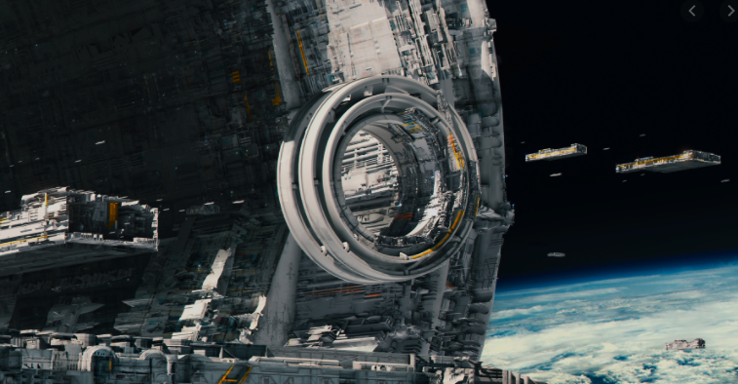
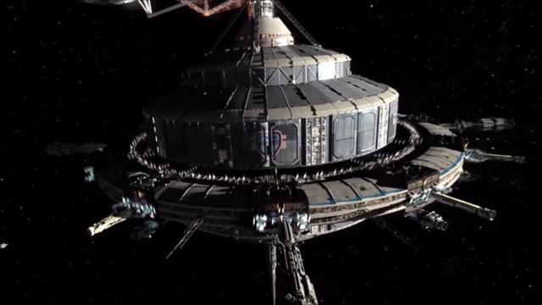
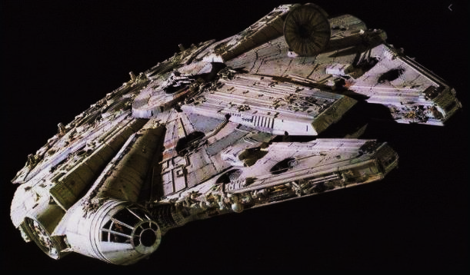
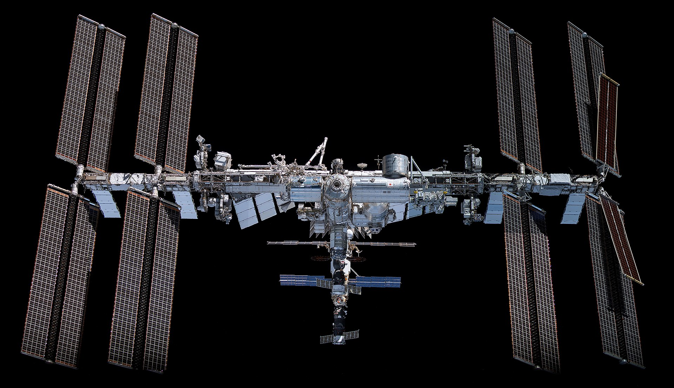
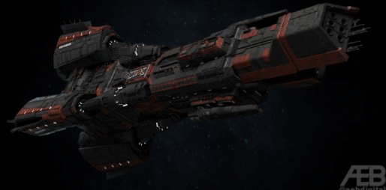
Inspiration
“AI is one of the most important things humanity is working on. It is more profound than, I dunno, electricity or fire,”
-Sundar Pichai (Google CEO)
Image source: https://expanse.fandom.com/wiki/Tycho_Station?file=Tycho-stn-3.png
Image source: https://www.artstation.com/artwork/Z5lYJm
Image source: https://en.wikipedia.org/wiki/Millennium_Falcon
Image source: https://mobile.twitter.com/aebdigital/status/1079504882393116674

Slide 4
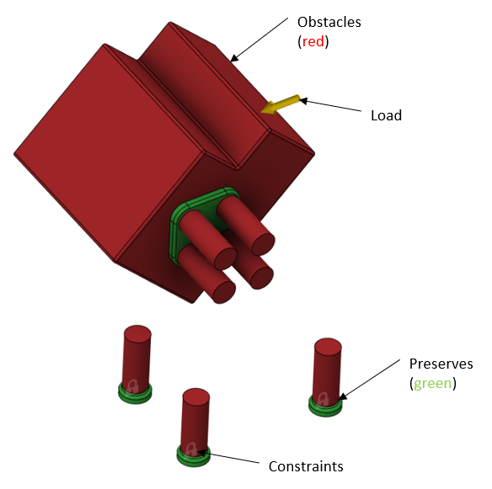
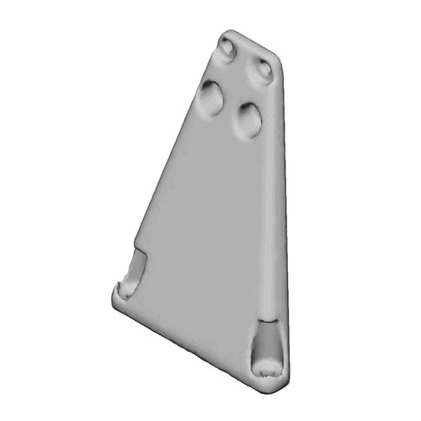
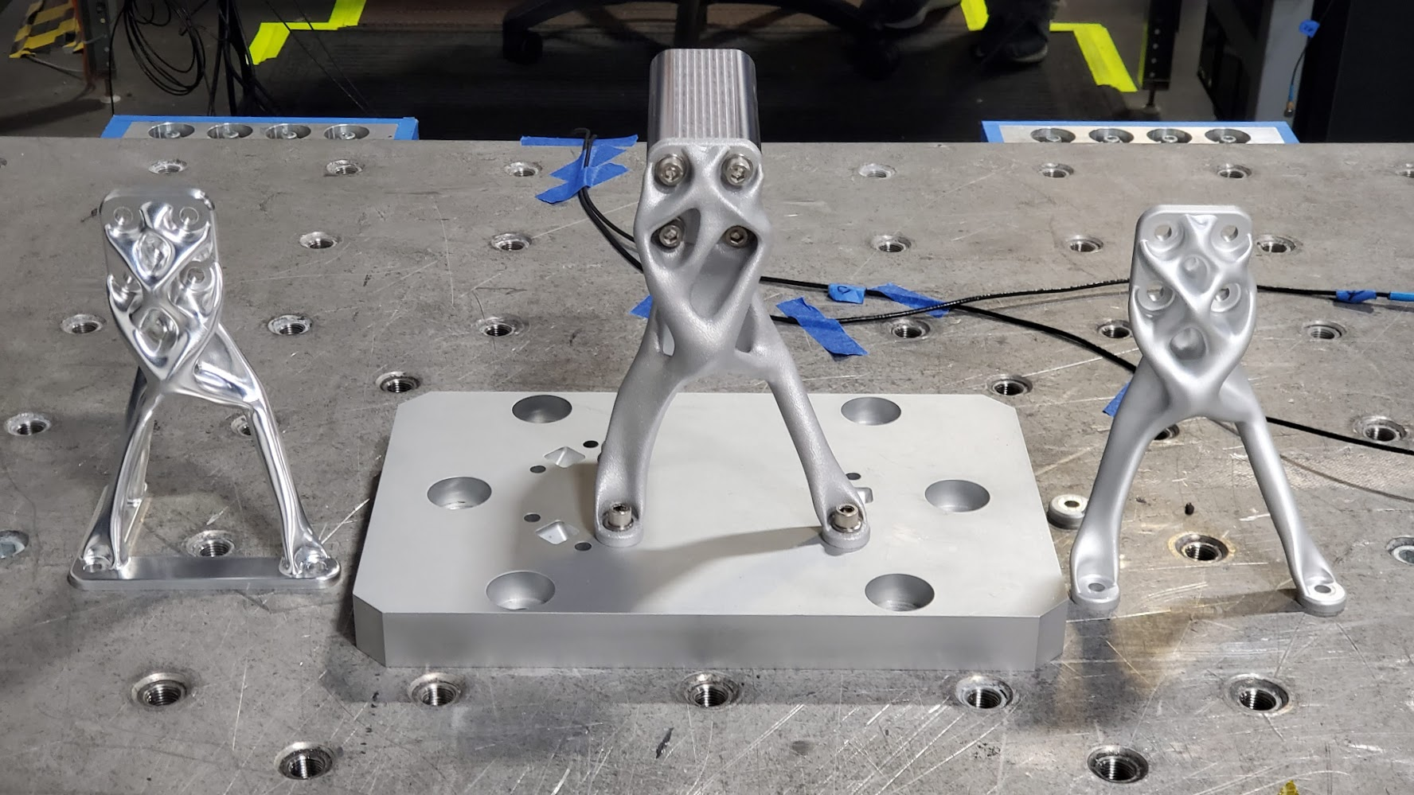
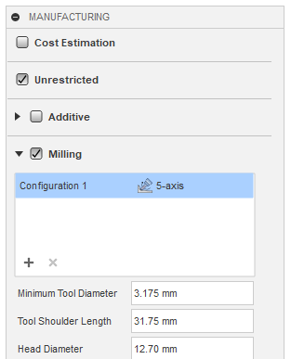
Evolved Structures Process
(1) Digitally encode structure requirements into software
Follow written Evolved Structures Guide for NASA applications
(2) Use Generative Design AI to evolve optimal designs meeting requirements
Using COTS software adapted for GSFC needs
(3) Fabricate parts directly from Generative Design output using Digital Manufacturing (software + robots)
Using industrial processes such as automated CNC and Additive Manufacturing (AM)
Input: Requirements ▶ Output: Parts
Encode Requirements
~1 hr
Evolve Designs
~1 hr
Fabricate Parts
1 day – 3 weeks

Slide 5
Benefits of Evolved Structures Process
Help GSFC win missions
2x-4x improved performance (mass/stiffness/strength)
10x reduced development time/cost
Virtuous cycle 🔄 lighter designs need lighter support structure
Lower mass = lower cost
Currently a unique capability of Goddard
Help GSFC deliver on funded missions
Solve mass challenges
Work more efficiently ▶ get more work done
Use modern computing to reduce tedious work so engineers can focus on challenges
Achieve more science per dollar
We can not build the ambitious missions of the future with the tools of the past

Slide 6
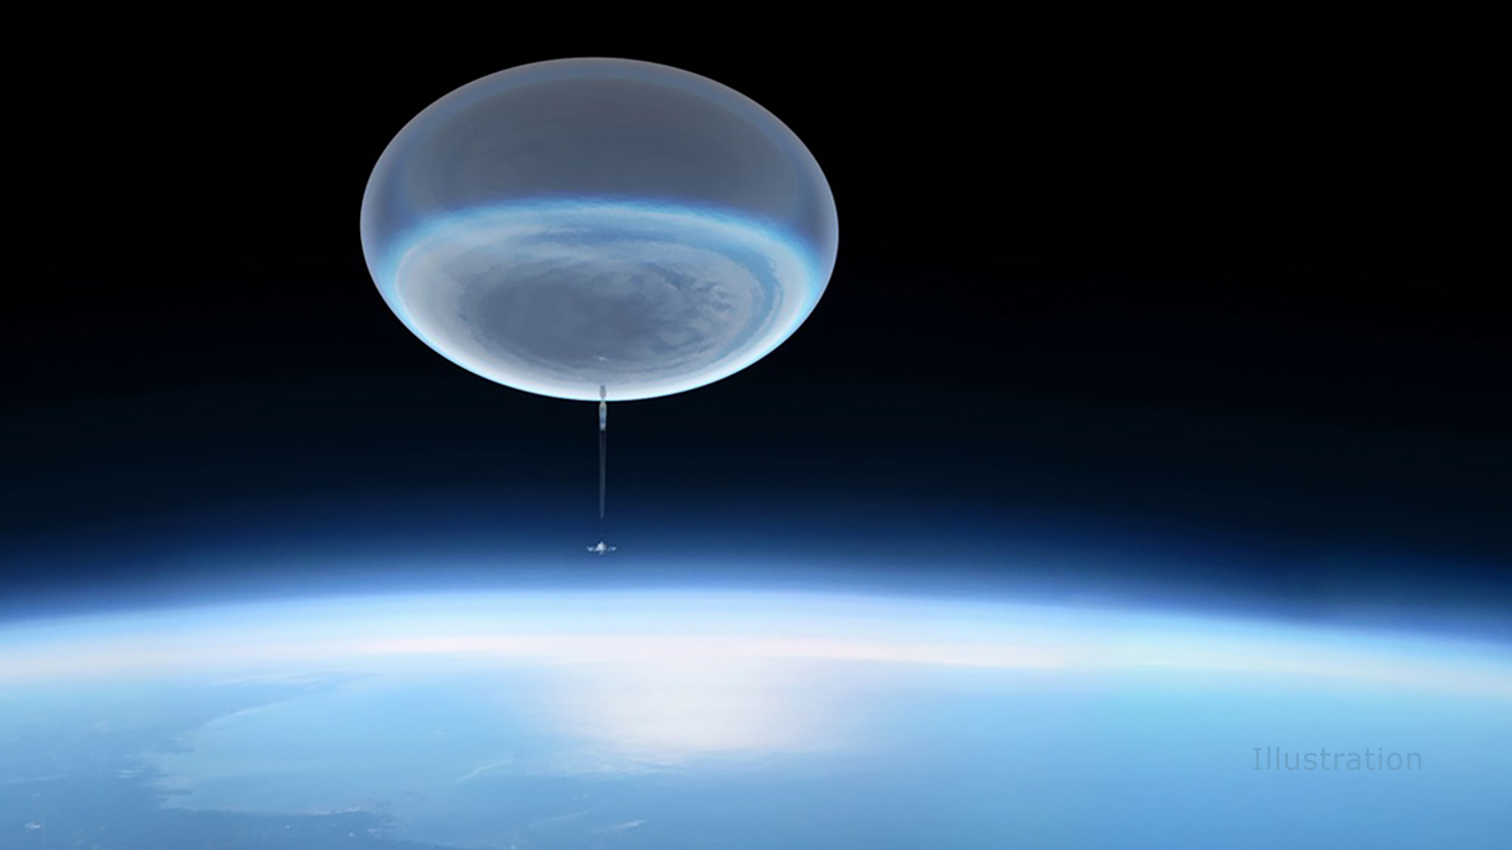
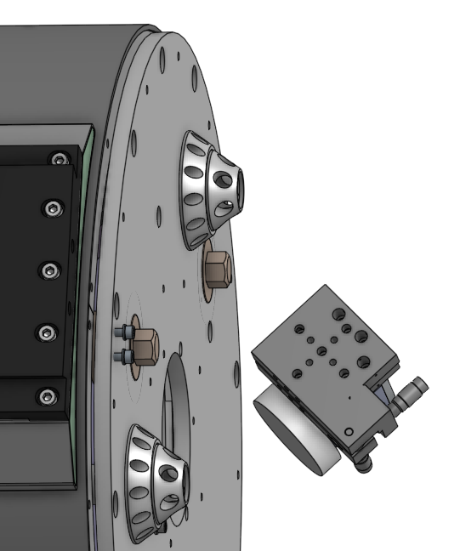
NASA EXoplanet Climate Infrared Telescope (EXCITE, PI: Peter Nagler)
Tip/Tilt assembly
40 km above Earth’s surface
Telescope
Image Source: https://www.jpl.nasa.gov/news/nasa-mission-will-study-the-cosmos-with-a-stratospheric-balloon
Notes:
Source Link: need to add paper from EXCITE
https://arxiv.org/abs/1903.09718
Will update weight + balloon – 1.5t to be updated, 400 ft to be updated,
Long Duration Balloon (LDB)
Check mass figure – may be 50-75%

Slide 7
Application Example: EXCITE Tip/Tilt Bracket
Mission: Analyze atmospheres of exoplanets
Goal: Mount Tip/Tilt mirror assembly to the back of the Telescope (PI: Peter Nagler)
Interfaces: Bolt pattern on Tip/Tilt stage and bolt pattern on Telescope. Avoid Tip/Tilt assembly volume and optical path.
Loads: 10g vertical (x) 3g lateral(y and z) applied to Tip/tilt stage center of gravity (1.35 kg mass)
Modes: >100 Hz per standard practices and to avoid cryo-cooler excitation
Bracket mass target: 0.2 kg
Tip/Tilt assembly
Telescope

Slide 8
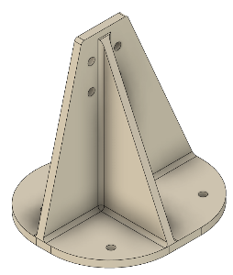
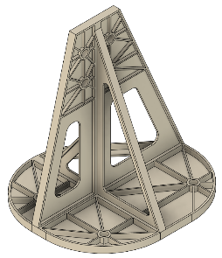
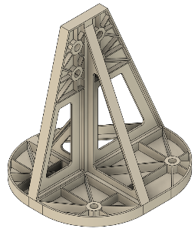
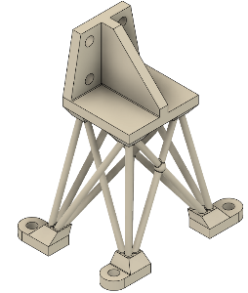
Application Example: Human Design
Design problem given to senior design engineer
Finite Element Analysis (FEA) done my me
Design improved with iteration
No manufacturable design meets the mass target
Elapsed time: 2 days
Human Designer Iteration | 1 | 2 | 3 | 4
Design (Aluminum)
Mass (kg) | 0.59 | 0.18 | 0.27 | 0.18
1st Mode (Hz) | 137 | 37 | 65 | 108
Stiffness/mass (Hz/kg) | 232 | 205 | 240 | 600
Max Stress (MPa) | 26.3 | 189 | 103 | 60.7
Manufacturing | CNC | CNC Difficult to machine hog-outs – no quote | CNC Difficult to machine hog-outs – no quote | Not machinable/ printable– no quote

Slide 9
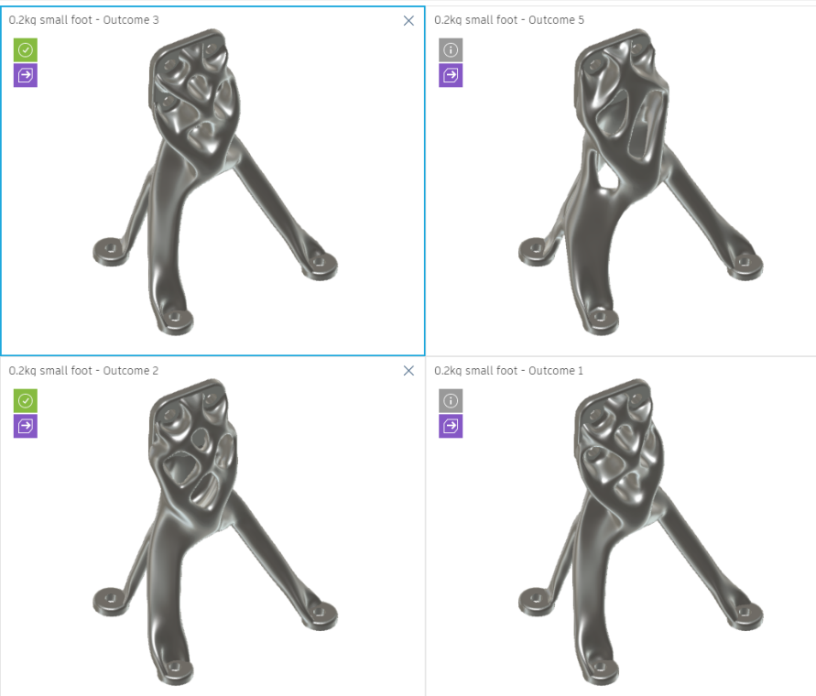
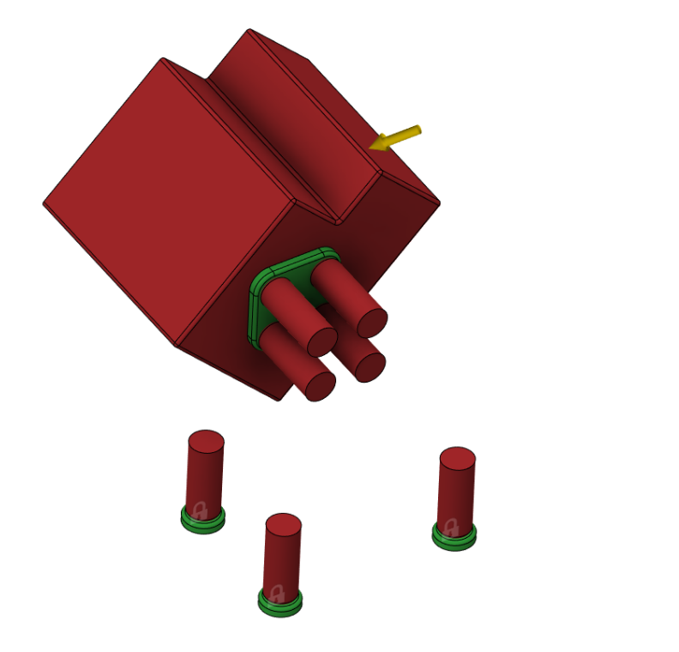
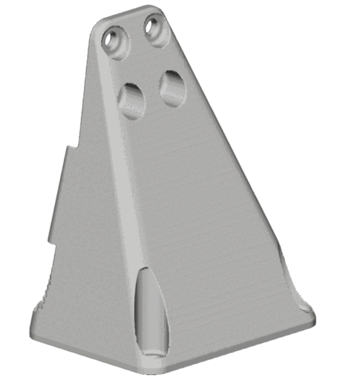
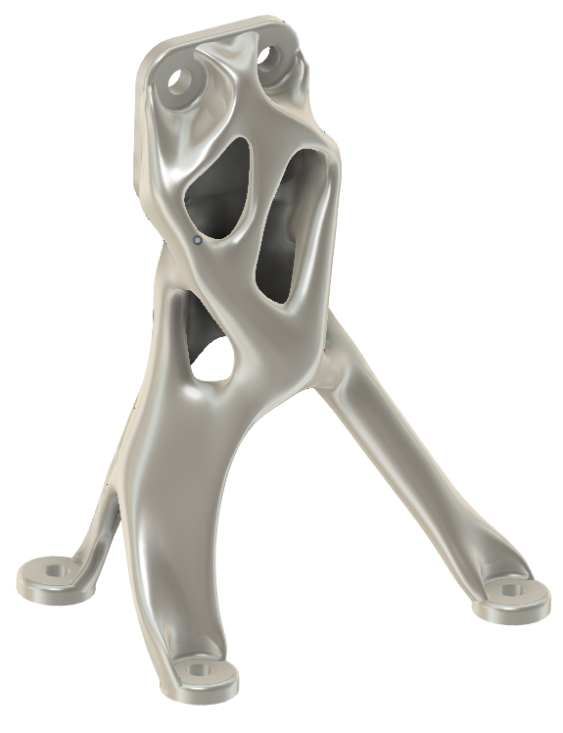
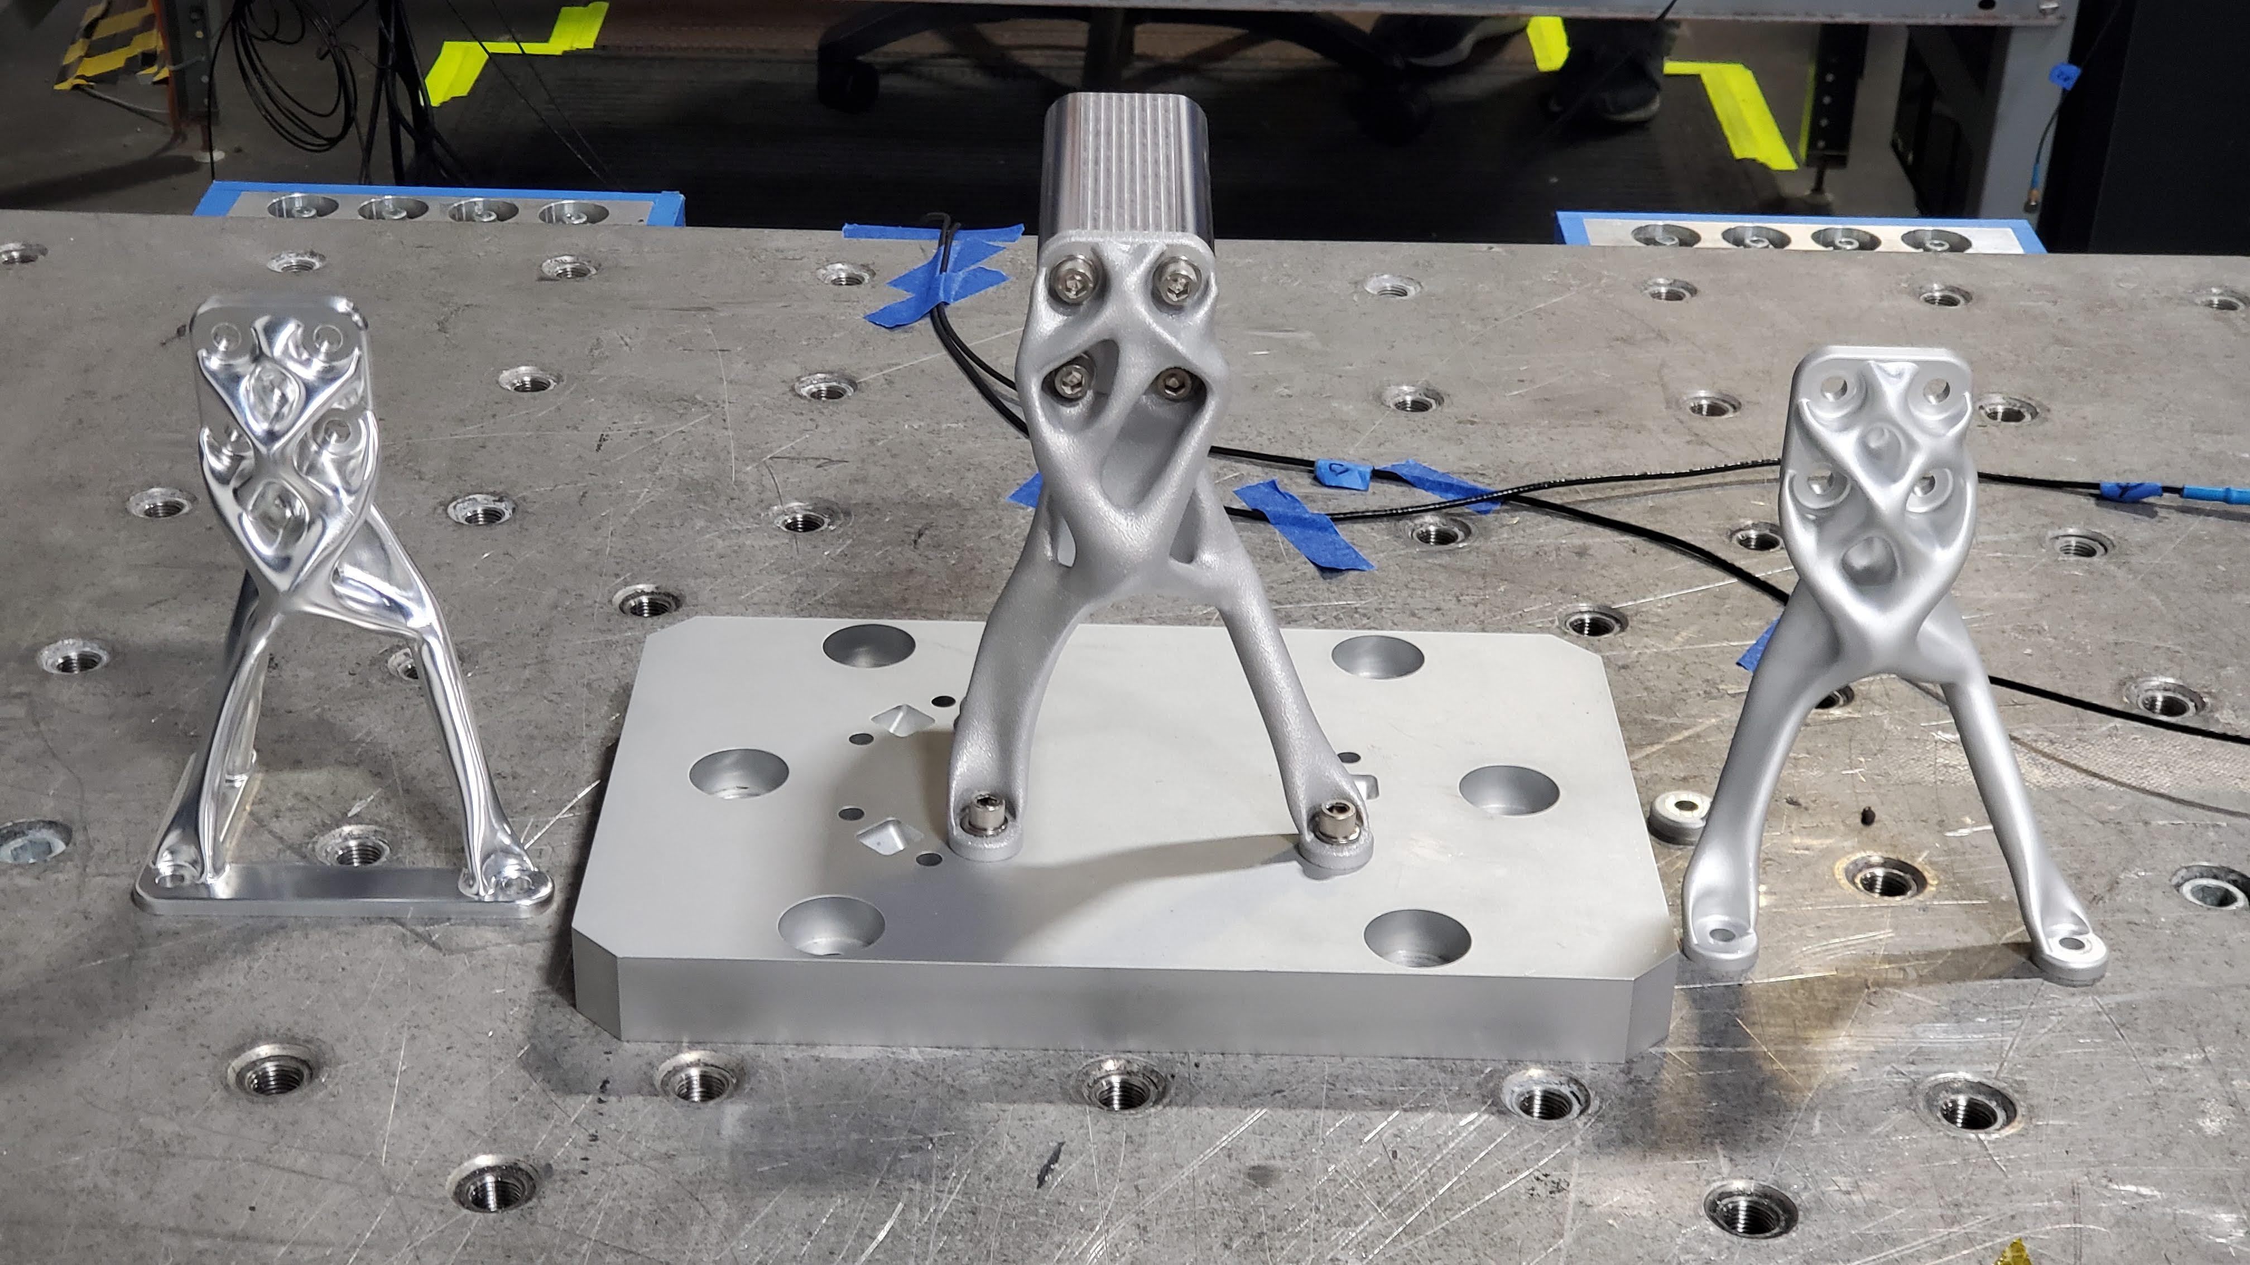
Application Example: Evolved Structures Design
Designer | Expert Humans (2X) | AI CNC | AI AM
Design
Design time | 2 days | 1 hour | 1 hour
Design iterations | 4 | 31 | 31
Mass (kg) | 0.27 | 0.2 | 0.2
1st Mode (Hz) | 65 | 147 | 177
Max Stress (MPa) | 103 | 14.8 | 11.2
Manufacturing | CNC - Difficult to machine (no quotes) | Automated CNC $1000 3 days | L-PBF AM $2000 3 weeks
Obstacles (red)
Load
Preserves (green)
Constraints
VALIDATED
Inputs
Outputs
Notes:
Validate with existing methods. Same as you do with human designs!

Slide 10
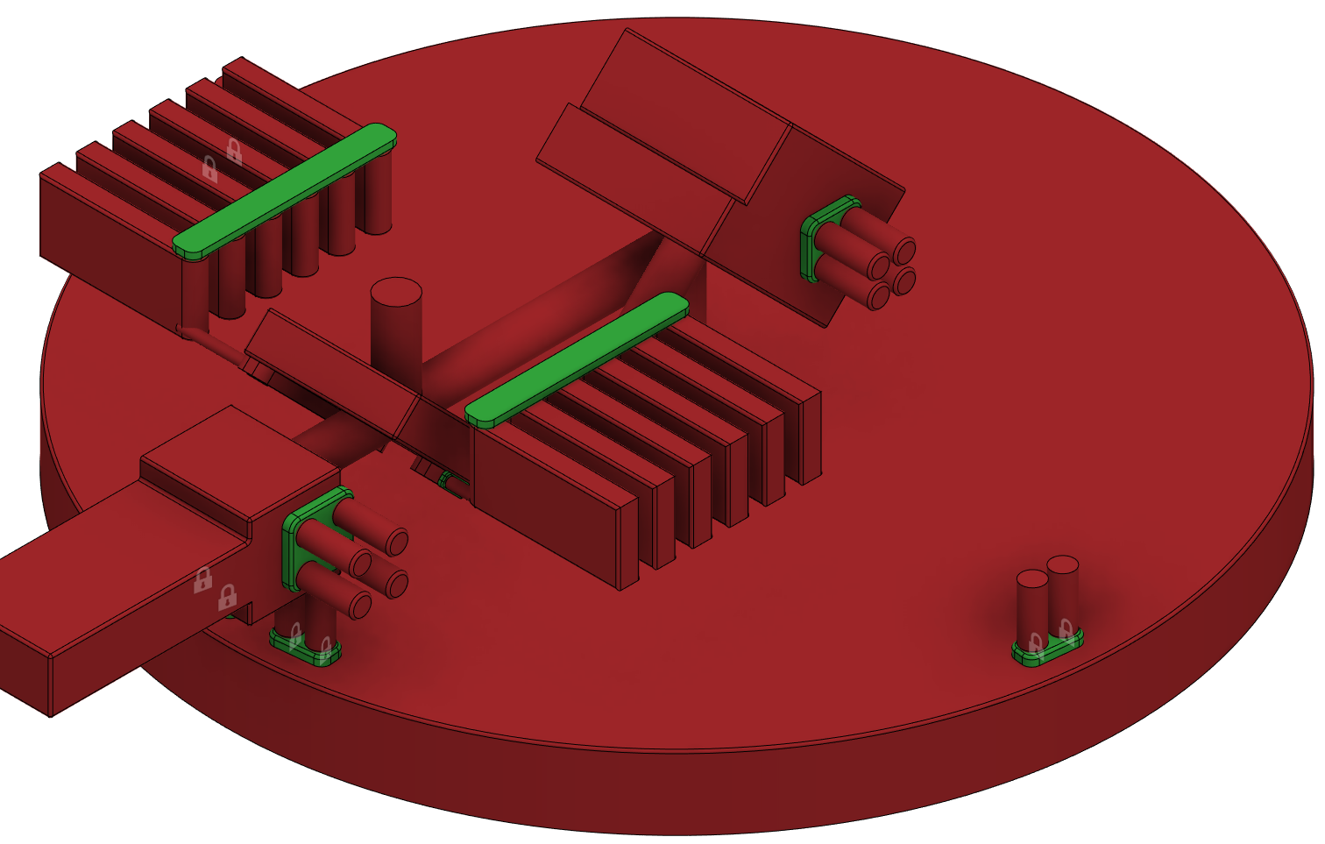
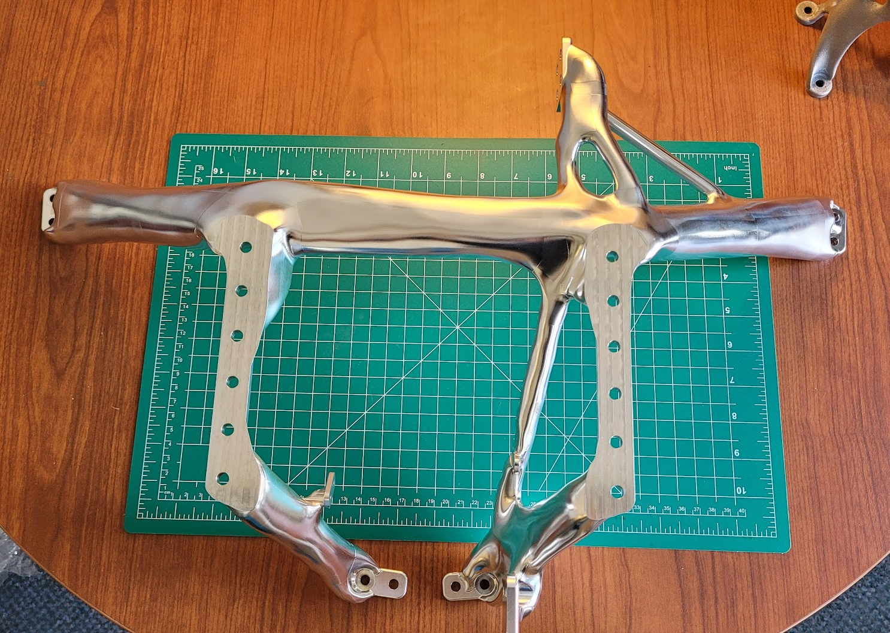
Case Study: EXCITE Evolved Optical Bench

Slide 11
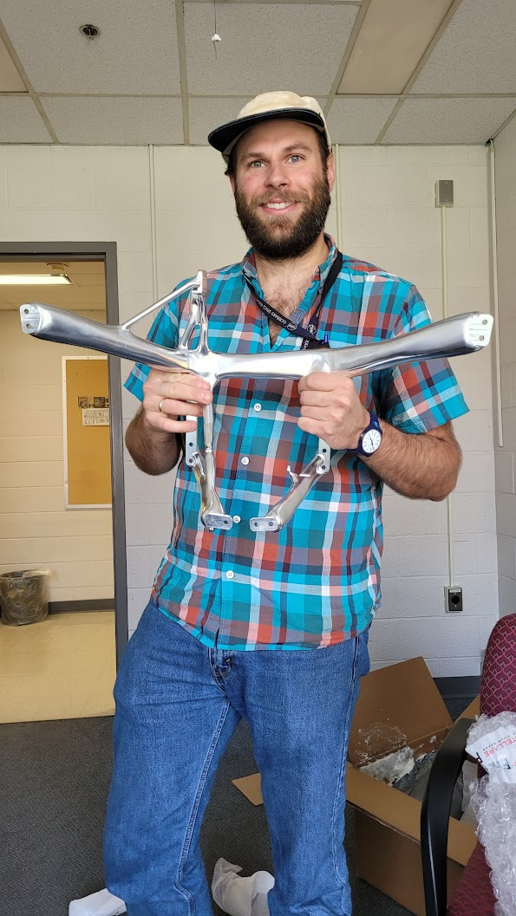
Case Study: EXCITE Evolved Optical Bench

Slide 12
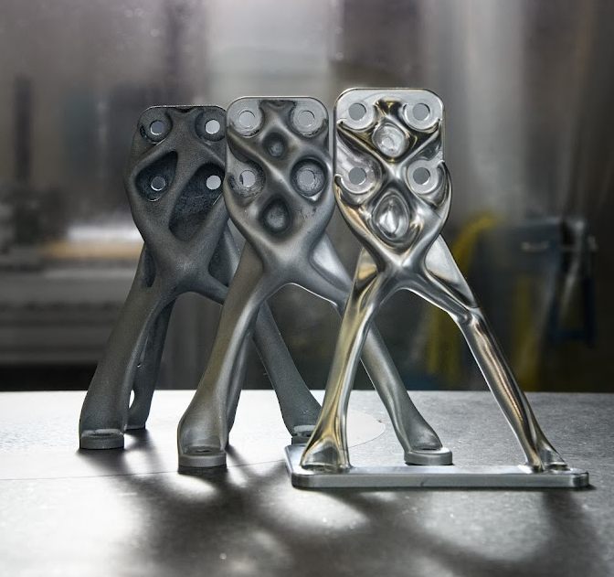
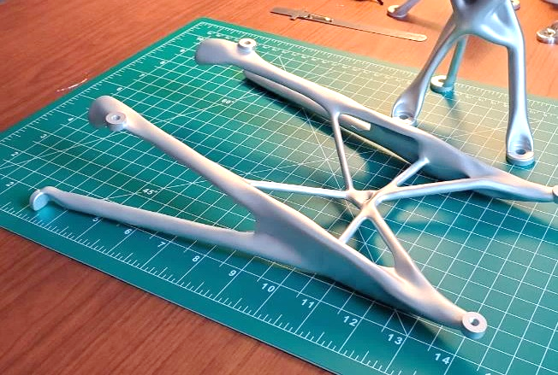
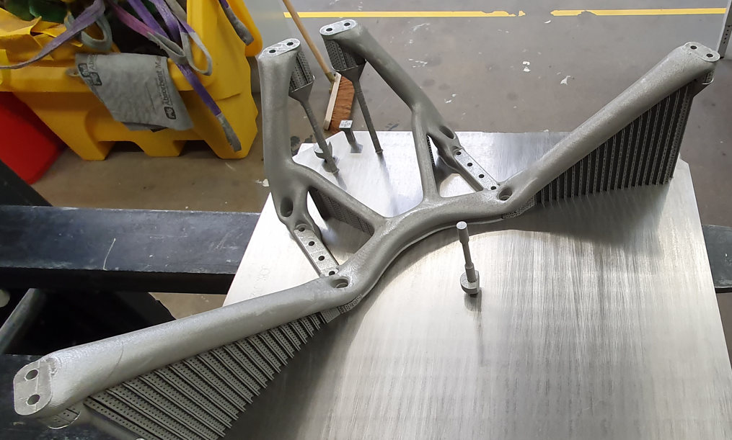
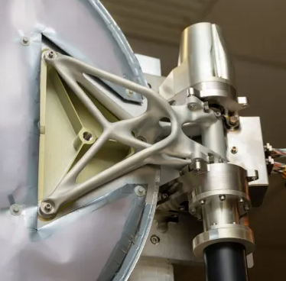
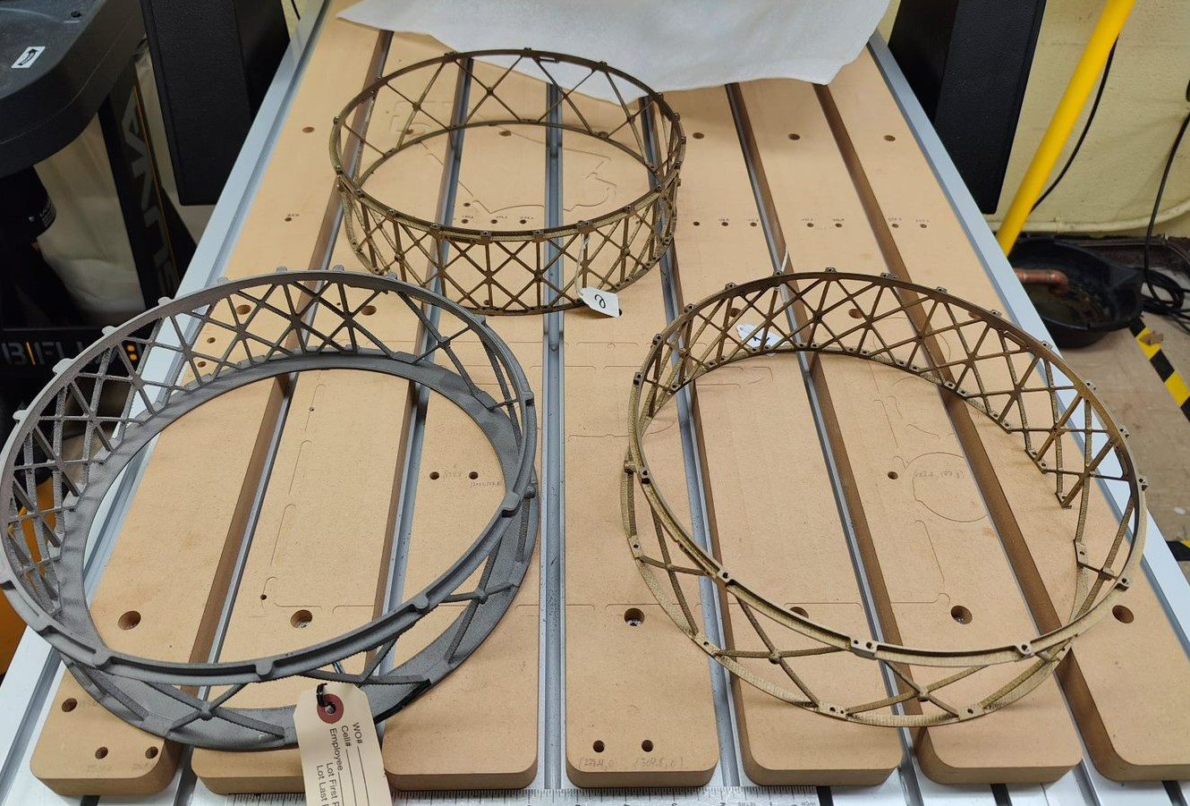
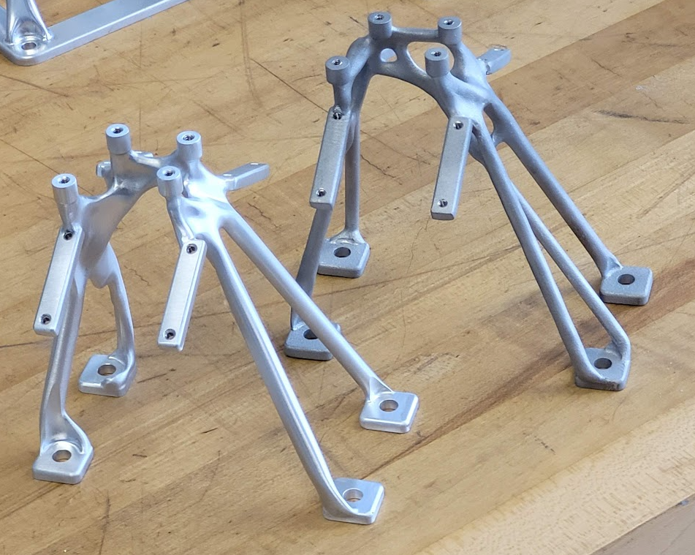
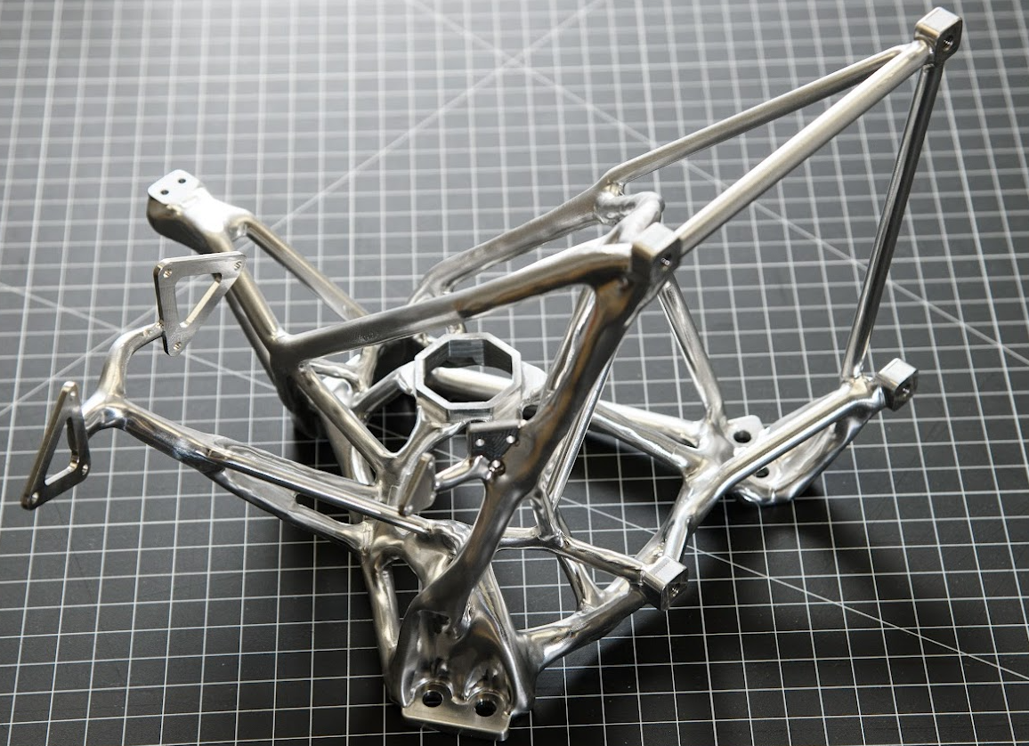
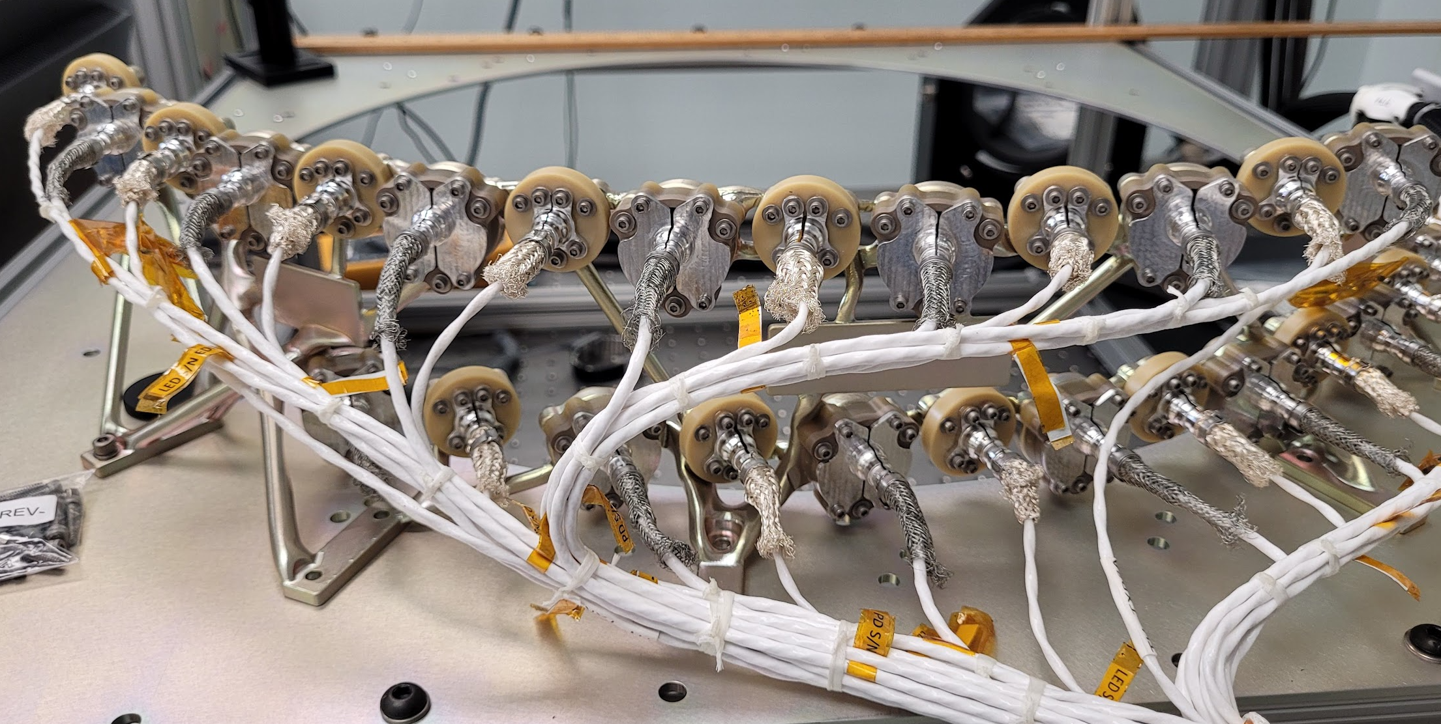
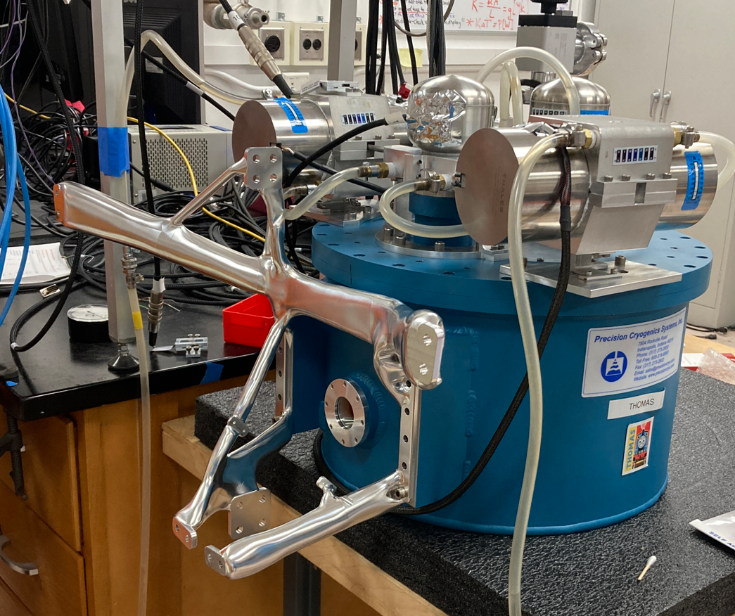
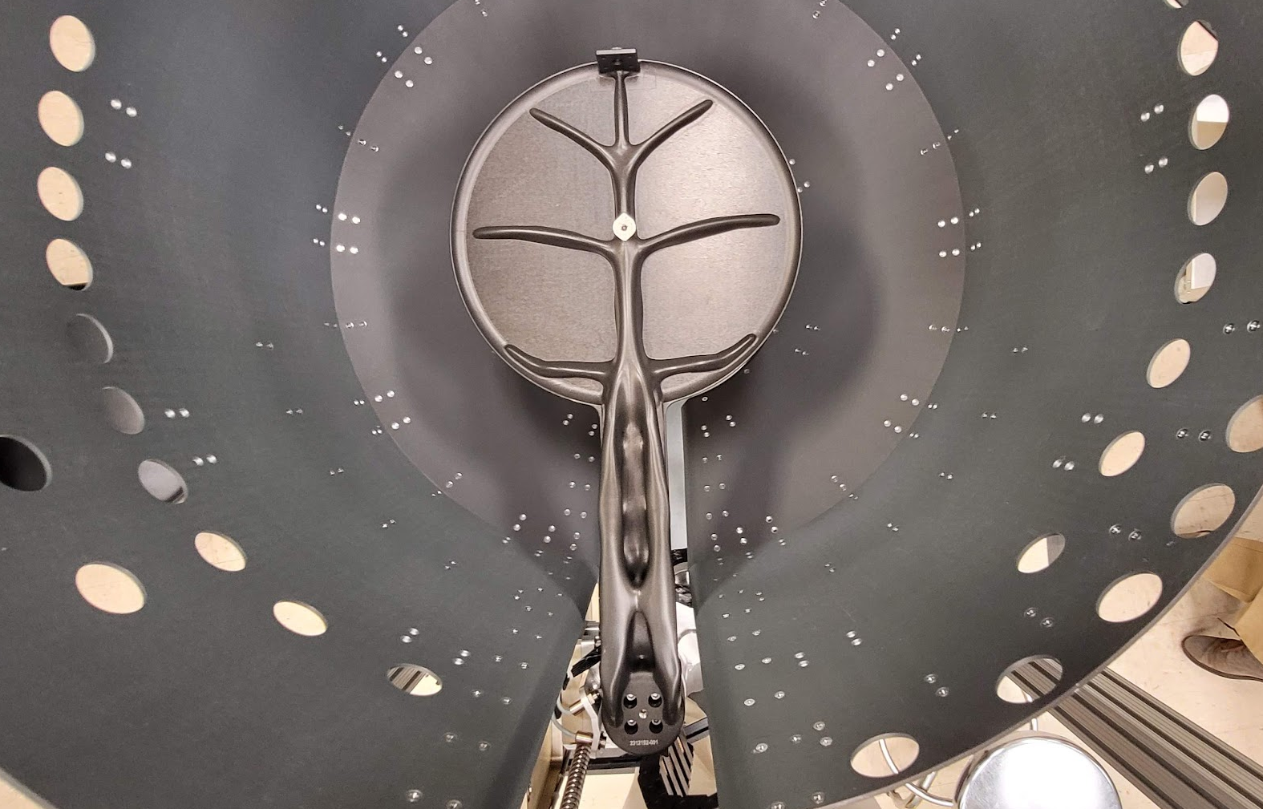
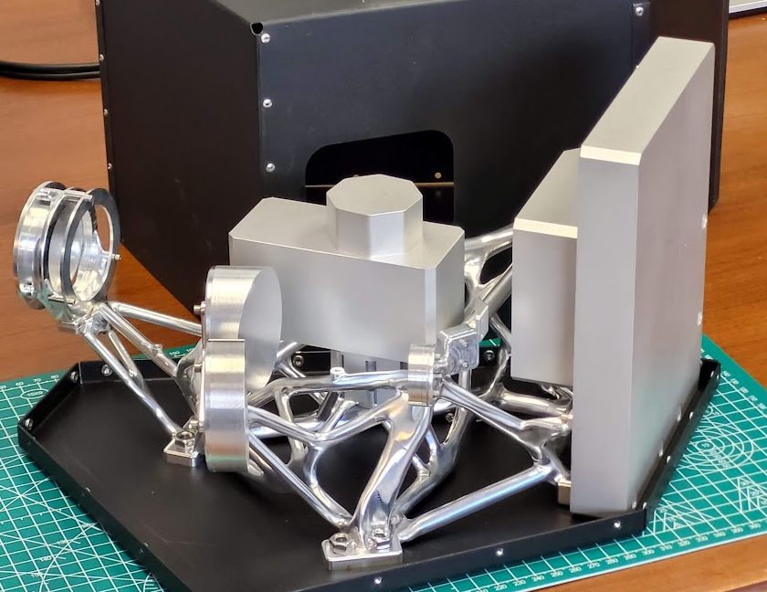
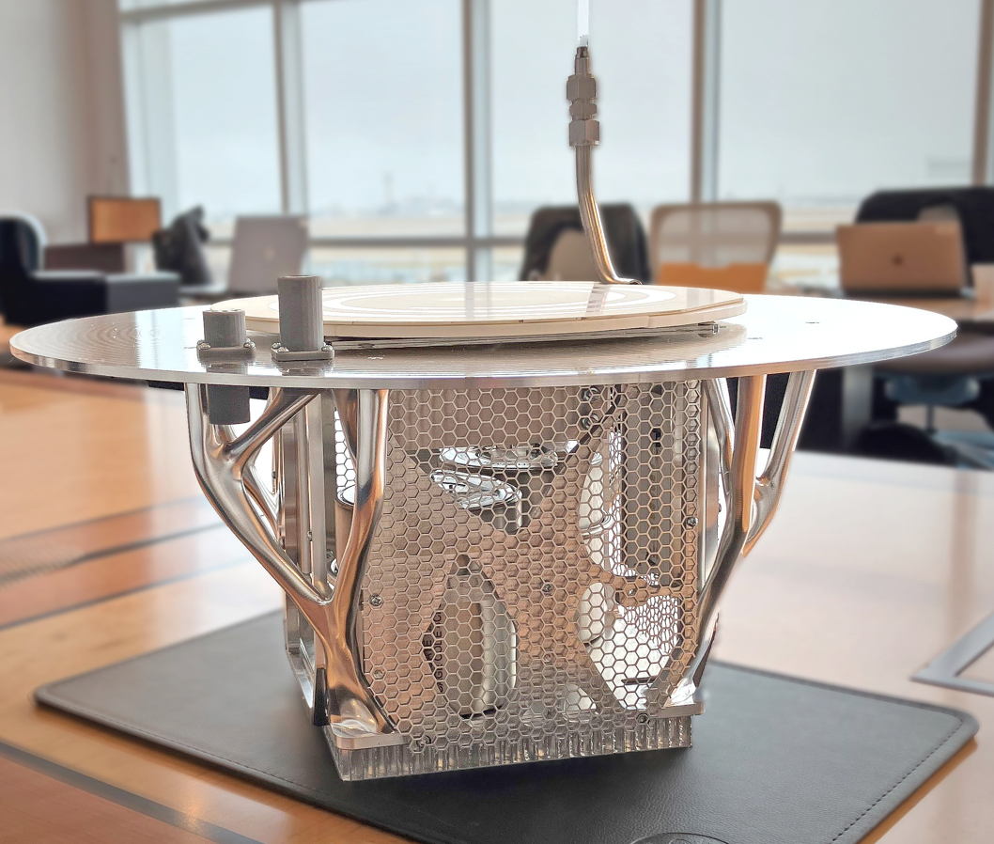
Application Examples
“The trick to having good ideas is not to sit around in glorious isolation and try to think big thoughts. The trick is to get more parts on the table.”
- Steven Johnson
EXCITE: Radiator mount
EXCITE: Detector mount
MSR-CCRS: Capture Lid
EXCITE: Tip/Tilt mount
DraMS Carousel Base
MSR-CCRS: Capture Sensor Bracket
LEXA: Lunar Spectrometer
Optical Bench
CCRS: LTM Paddle
EXCITE: Optical Bench
Venus lander
Optical Bench
Notes:
Lesson: first find low hanging fruit, demonstrate value, then scale up

Slide 13
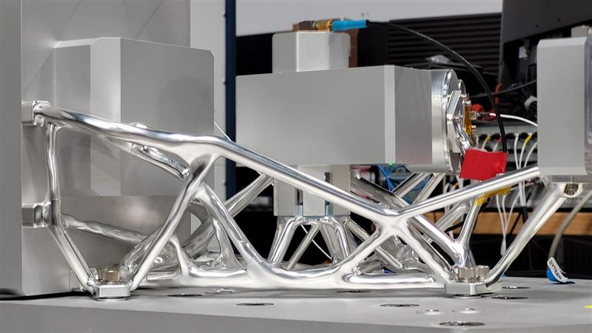
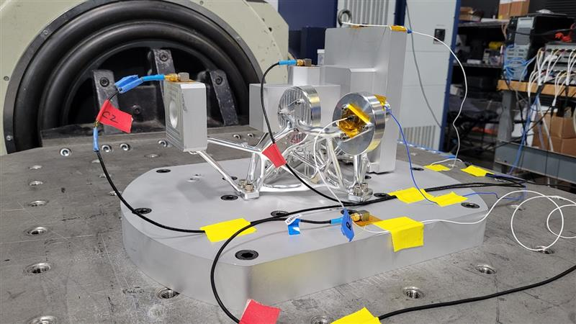
Case Study: ALICE Evolved Optical Bench
Earth Science Instrument for STRIVE mission
Radically lightweight structure
Reduced from 3.6 kg to 610 gms!
Consolidates 10 parts from the original design
CNC machined from a single block of Aluminum
Successfully vibration tested to GEVS standards
Demonstrates Evolved Structures as an enabling technology for future instruments
Reducing mass creates a virtuous cycle, enabling other parts of the system to be lighter and reducing power consumption, all of which ultimately reduce cost
Next step: reduce entire instrument mass to fit on a smaller mission class
Notes:
Example of EXCITE Tip/Tilt Bracket shows game changing improvements in development time/cost (16 hours vs 1), mass/stiffness (3x improvement), stress (4x reduction), and manufacturability. Human design could be improved with further iterations, but it would take weeks.

Slide 14
Generative Design: Paradigm Shift
Current GSFC Process
Design requirements and goals
Designer creates CAD model
Analyst checks against requirements
Designer generates drawing
Machinist evaluates drawing
Fabrication
Inspection
Qualification
Flight
Months-Years
Evolved Structures Process
Design requirements and goals
AI Generates Designs; checks requirements and fabrication
Digital Manufacturing
Inspection
Qualification
Flight
Engineer focuses on requirements
Hours-Days
Demonstrated: Requirements known to parts in-hand in <2 weeks. 2x-4x lighter.

Slide 15
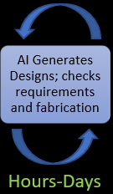
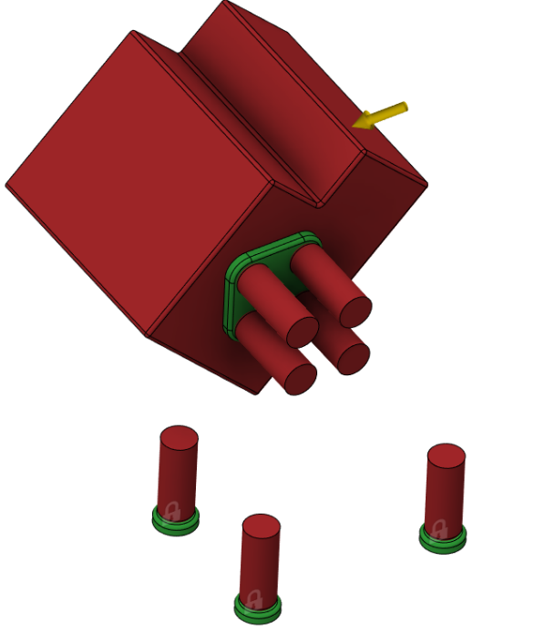
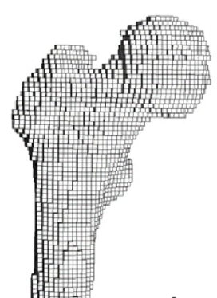
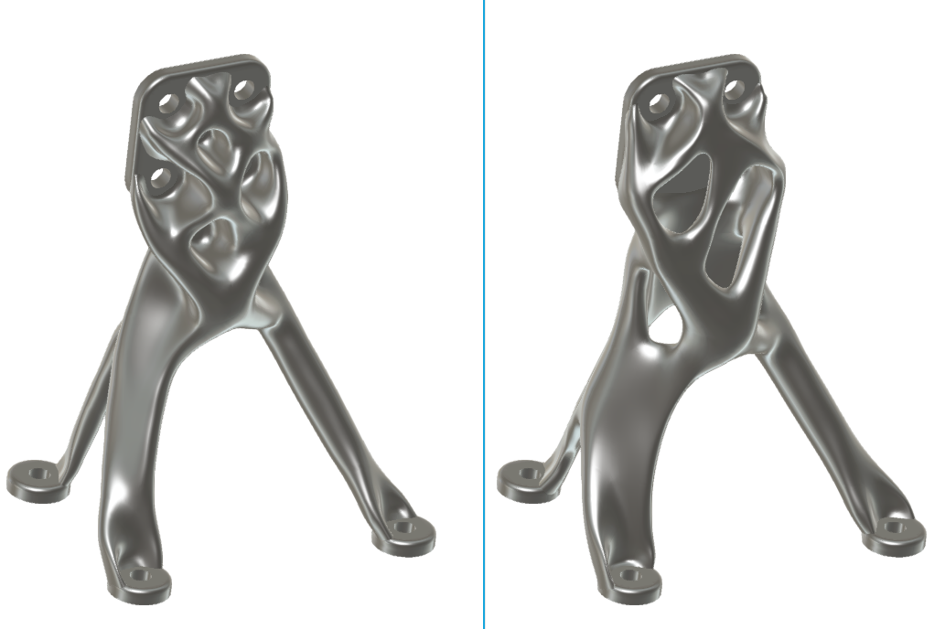
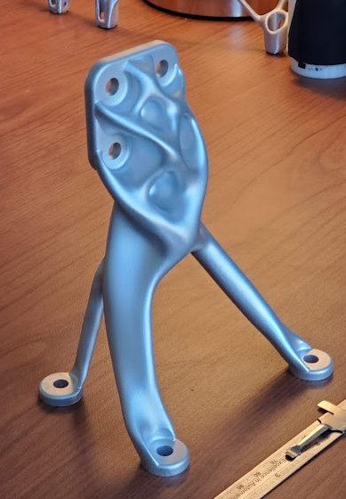
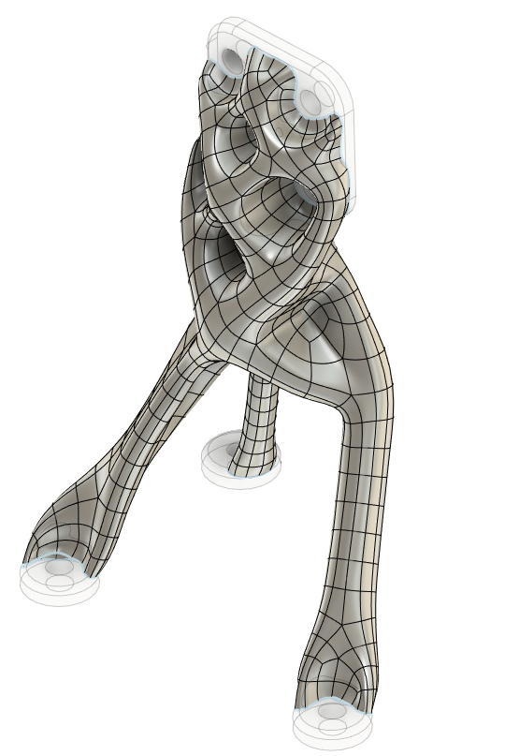
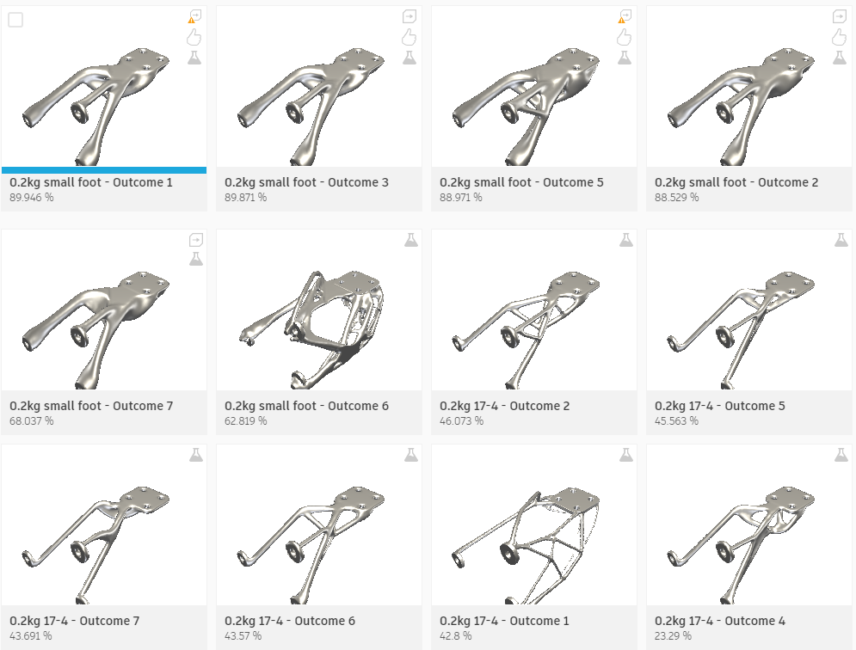
Generative Design: How the process works
AI: Computer systems able to perform tasks that normally require human intelligence
User inputs
Create voxel mesh of design space
Run Topology Optimization
Output results for user review
Reconstruct CAD model of selected outputs

Slide 16
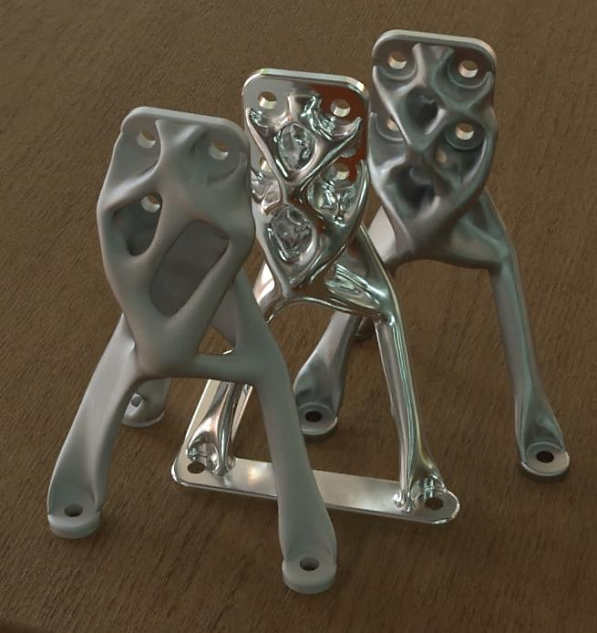
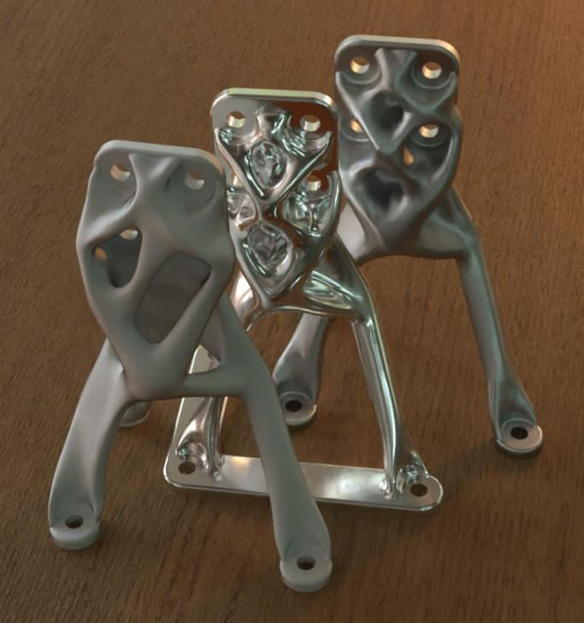
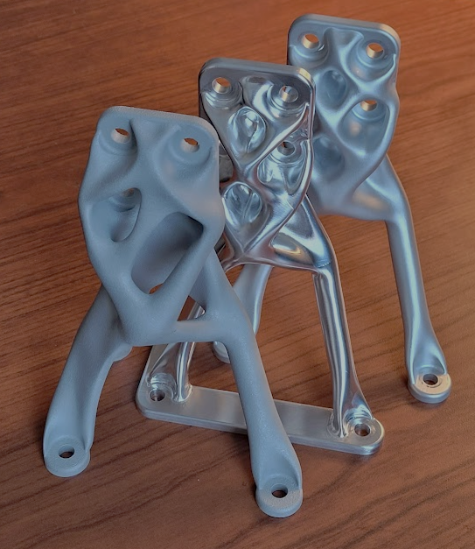
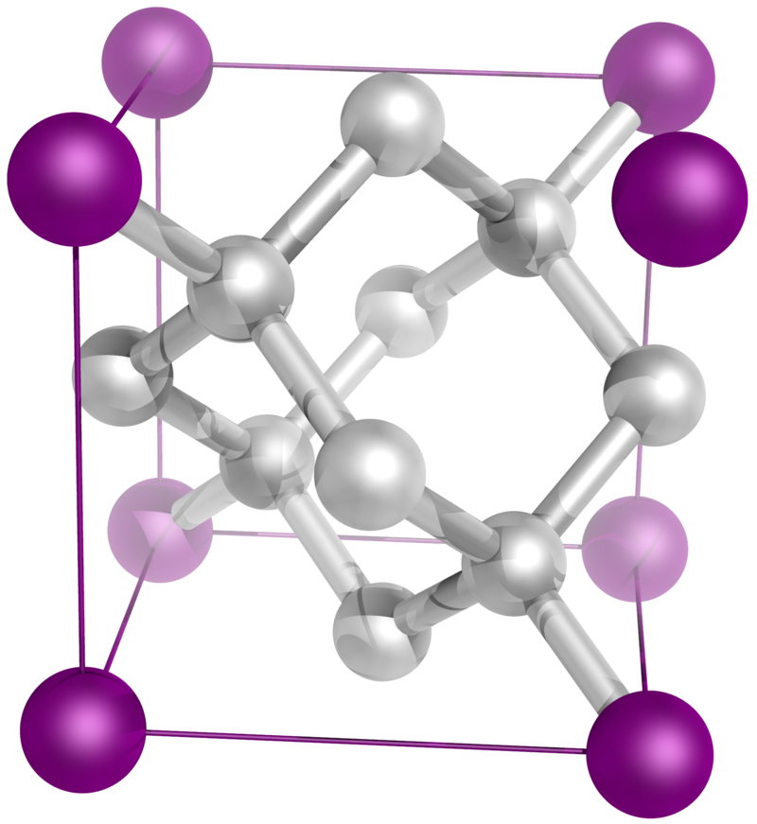
Digital Manufacturing: Robots turning bits to atoms
Bits
Atoms

Slide 17
Digital Manufacturing
CAD ▶ CAM ▶ Code ▶ Robot ▶ Part
Most of the time CNC is best
Generative Design creates parts that are fundamentally stiff and machinable
Commercial CNC capabilities far exceed most engineer’s expectations
Material properties superior to AM
More ductile, more predictable
Vendor suggestions: CNC 5-axis Machine Shop Master List.xlsx
AM (3D Printing) advantages and costs
More design freedom ▶ greater performance (~10%-20%)
Fabrication cost lower for expensive-to-machine materials
Titanium, Inconel, etc
Material properties are process dependent
But: Additional verification and documentation required
NASA-STD-6030 – depends on mission class

Slide 18
CNC vs. AM for Evolved Structures (Today)
AM generally has cost and schedule disadvantages for aerospace
Limited choice of AM vendors, especially for parts >250mm
Material properties process dependent, varies by vendor
Tolerances are poor compared to CNC – post machining
Surface finish is rougher than CNC machining.
Removal of supports requires manual finishing, leading to variable surface quality
Heat treatment usually required
Additional testing and inspection required NASA-STD-6030
Build failures expected
Need a compelling reason to use AM
Unmachinable features like internal voids and channels

Slide 19
AM for Evolved Structures (Future)
Cost and schedule will improve due to mature technologies, marketplace, and standards
Generative Design and AM will enable large monolithic structures
Vastly improved performance
Vast reduction in part count
Image source: https://www.wired.com/story/massive-ai-powered-robots-are-3d-printing-entire-rockets/
JPL

Slide 20
Project Infusion: Lessons Learned
Earlier is easier ▶ more design freedom ▶ more mass savings
Pre-Phase A (e.g. proposal phase) is ideal
Load path understanding ▶ better structure layout
Pre PDR-EPR is good, ideally have a physical prototype at PDR-EPR
Virtuous cycle 🔄 compounds the advantages ▶ help win missions
Lighter designs need lighter support structure and smaller ACS components
Stiffer designs have less jitter
Lighter designs have less surface area and/or volume ▶ less heating/cooling ▶ smaller radiators/heaters ▶ less mass/cost
More science per dollar
Key to success: identify a promising application
Small to mid-size parts, generally < 1 meter max dimension
Metallic (Aluminum, Titanium, or Invar)
Need to support components, detectors, optics, reaction wheels, etc
Not just replacing a honeycomb plate or composite tube
Truss layout for larger structures

Slide 21
Project Infusion: Prototype to Baseline

Slide 22
Heritage
Topology Optimization techniques developed in the 80s with commercial software integration in the 90s
Altair OpiStruct
Thales has flown many Generatively Designed parts
Hundreds flown on commercial missions
Large antenna brackets flown on NASA SWOT
JPL cable bracket for Europa Clipper
Qualified for flight (2024 launch)
SpaceX uses Generative Design commonly

Slide 23
Project Infusion: System-level Analysis
Structural Analyst thinks system-level analysis will be too hard/slow
Challenges overcome and documented on CCRS LTM Paddle, CLM Arm, and Capture Sensor Bracket
Fusion 360 can output a NASTRAN FEM directly ▶ work with analyst on meshing
Four techniques for model reduction
Reduced tet mesh (e.g. CCRS LTM Paddle, CLM Arm)
Reduced plate and beam model: Fusion 360 can help
SuperElement model
Smeared mass for CLA (Capture Sensor Bracket)
Thermal Analyst thinks system-level analysis will be too hard/slow
Challenges overcome and documented on CCRS LTM Paddle, CLM Arm, and Capture Sensor Bracket
Reduced primitive models
Fusion 360 can create primitive geometry ▶export curves and surfaces
Fusion 360 thermal analysis can be used to quickly check conductance
Get analyst input as after first design iteration if possible

Slide 24
Getting Started with a New Application
Evolved Structures Team funded for mission infusion
Can provide preliminary design and analysis support at no cost
IRAD funding also available for prototype fabrication
Sustaining engineering provide by trained project engineers with expert consultation
What to expect:
Application assessment
1 hour
Generative Design Application Checklist
1 hour
Design and analysis provided to project
1-3 days
Feedback or
Req. change
Providing proven technology to expedite development, arriving at a technically superior solutions, for no initial project cost

Slide 25
Conclusion and Call to Action
Evolved Structures provide significant benefits to NASA missions
2x-4x improved performance (mass/stiffness/strength)
10x reduced development time
Virtuous cycle reduces mission costs: more science per dollar
Ready for broad mission infusion
Embraced by major GSFC projects
Infusion process defined by code 500
Flown on NASA missions
Complex parts fabricated and tested
Contact the Evolved Structures team to get started

Slide 26
Training Resources
Evolved Structures Team: Funded for infusion
ryan.s.mcclelland@nasa.gov, matthew.vaerewyck@nasa.gov
Generative Design MS Team
Fusion 360 help channel
Evolved Structures Guide for GSFC Applications: living document
Download and install Fusion 360 trial
Elevated Privileged not required
Assess and cleared: CITR SHELF - Commercial IT Request (CITR) (nasa.gov)
Get a full license from the Generative Design Team
Take self-paced free training: Fusion 360 Help | Course: Introduction to generative design | Overview | Autodesk
Google and Youtube are also good for finding solutions
More training linked in Evolved Structures Guide

